Slide 1
LARC Quality Improvement Collaborative
Introductory Webinar:
Need-to-Know Information to Prepare for LARC
LARC

Slide 2
Introductory Webinar
For TODAY
OVERVIEW / SENSITIZATION
LARC Collaborative Overview Why? What? When? Quality Improvement Guiding Principles Model for Improvement DMAIC Metrics/Measurement
IN-COUNTRY PREPARATION
Preparation for Smart Start (On-site Session) / Process Mapping Stakeholder Analysis Team Formation Planning / Timeline
Sensitization
/ Overview
In-country Preparation

Slide 3
WHY
Notes:
Why does quality matter?

Slide 4
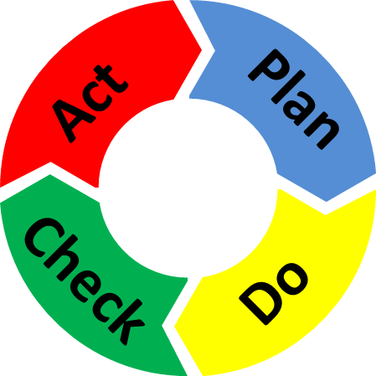
Quality Improvement is all about CHANGE!
Old Process
Tests of CHANGE
Sustain the New CHANGE
Implement the New CHANGE
Notes:
The skeleton of the Quality Improvement process…

Slide 5
The great aim of education is not knowledge, but action!
Herbert Spencer

Slide 6
Purpose/Expectations: To create an improvement culture where team members understand and utilize practical QI tools:
to successfully complete a QI project
and
to make CQI the way you work for the future!

Slide 7
Embed Improvement in your DNA

Slide 8
LARC = Measurable RESULTS
LARC 1.0 - Results from 6 countries (2016-2017)
LARC 2.0 – Results from 5 Sites in Kenya (2018-2019)
Notes:
WHY – Because LARC is proven to be effective in creating improvement!

Slide 9
To increase the percentage of viral load samples collected from eligible patients from 45% (Jul 2016) to 80% by Aug 2017
To increase the percentage of viral load tests ordered for eligible patients from 0% (July 2016) to 80% by June 2017 in CPN, CCR, and ARV clinics
To increase the percentage of patients with viral load results placed in their files from 4% (October 2016) to 80% by June 2017
Mozambique
Malawi
Kenya
LARC Project
spread to
all Clinic
Clinician Education
All Clinic
Clinic Director Follow-up
Clinician Education began
Nationwide HCW strike
To increase the percentage of high viral load patients with documented timely follow-up from 12% (average from Dec’15 to June ‘16) to 80% by June 2017
To increase the percentage of high VL patients with a documented return visit from 35% (Oct 2016) to 100% by June 2017
To increase the percentage of high VL patients 1) contacted ≤ 1 week after results receipt from 27% to 90%, and 2) initiated with IAC ≤ 1 month from 6% to 90% between June 2016 and June 2017
Swaziland
Tanzania
Uganda
Baseline
HVL register implemented
IAC forms implemented
HVL stickers on patient files

Slide 10
Riruta Health Centre
To reduce the number of missed appointments due for viral load test from 25% to 10% by March 2019
Embakasi Health Centre
To reduce % of missing viral load results in the viral load tracking log from 2% to 0% by March 2019
Thika L5 Hospital
To increase % of hardcopy viral load results placed in patient files from 0 % to 90% by March 2019
Due to result delays, 100% results were missing in last 2 periods (not shown here)
Delay of results due to reagent shortage
Maragua Sub County Hospital
To increase the % of HVL results documented in the green cards in patients’ files from 23% to 80% by March 2019
Baraka Dispensary
To decrease % of patients with HVL not attending EAC within 30 days of receiving results from 48% to 10% by March 2019

Slide 11
WHAT
Notes:
Next, let’s discuss WHAT… WHAT is LARC…

Slide 12
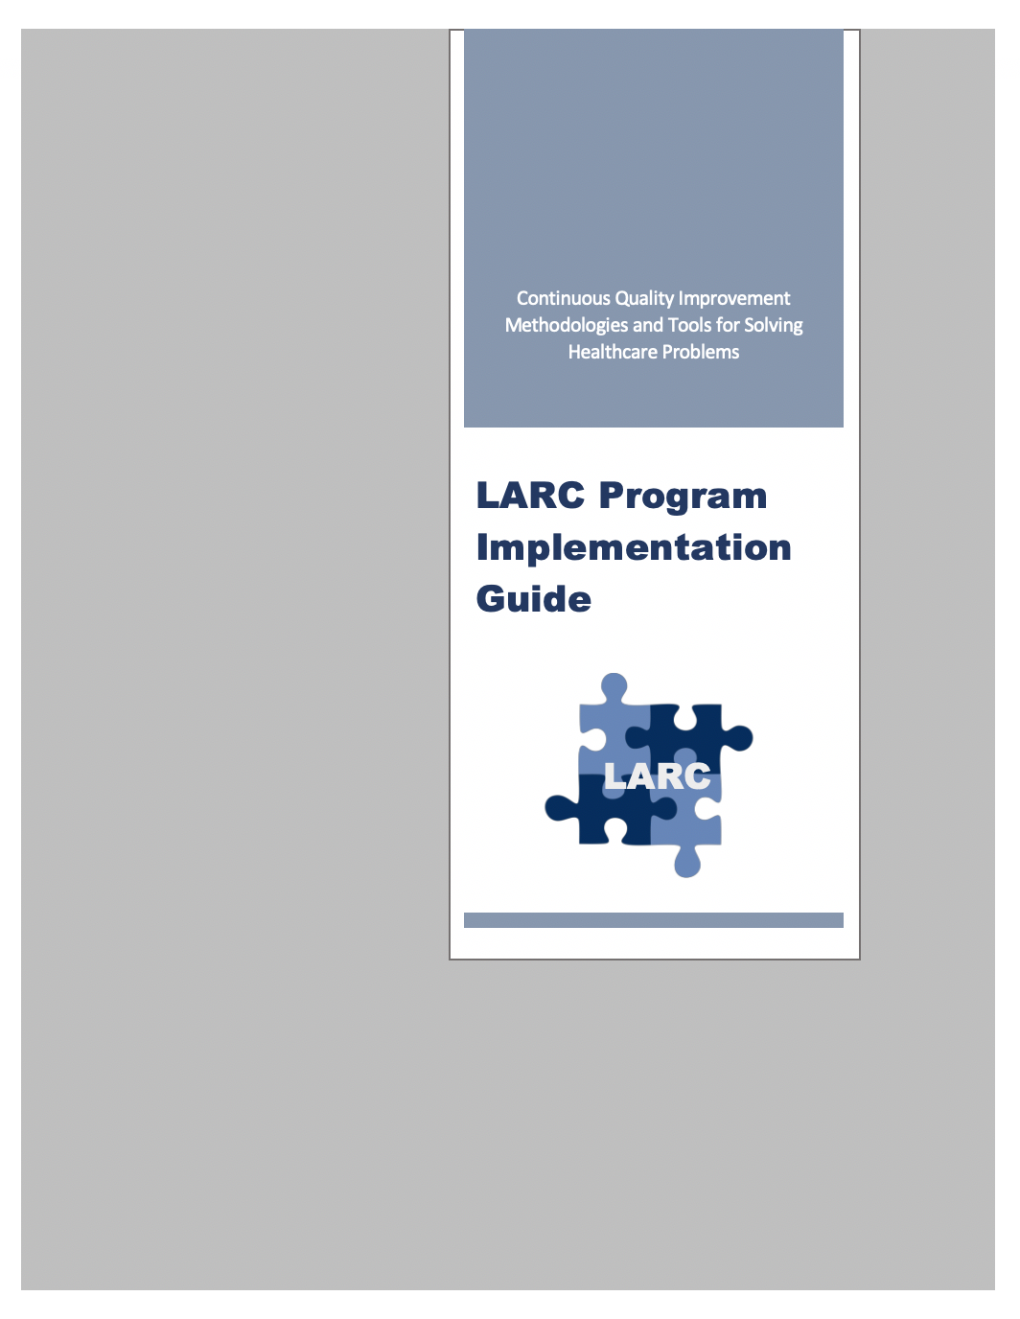
Frequently Asked Questions (FAQs) What is LARC?
Learning Collaborative Initiative → Improvement
To achieve better patient/client care, to improve measurable results, through a multidisciplinary, CQI approach
To advance and embed institutional improvement capacity and effectiveness
larccqi.org

Slide 13
Quality Improvement
Old Process
Tests of CHANGE
Implement the New CHANGE
Sustain the New CHANGE
Define
Measure
Analyze
Improve
Control
Notes:
Adding in elements of the Quality Improvement process… This is an introductory overview. You will see this again. It will all become clearer. For now…
DMAIC – the framework for approaching quality improvement
PDSA – a very useful and essential QI tool

Slide 14
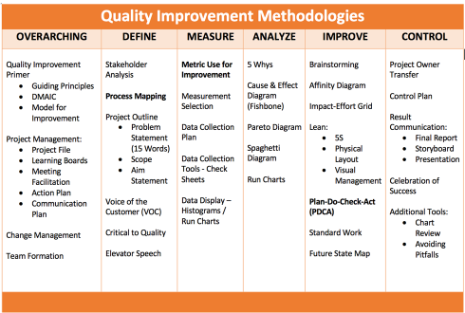
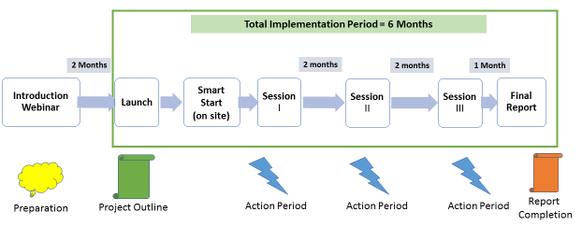
Curriculum + Delivery Model = Outcome
Curriculum
Program Delivery Model
QI Concepts/Skills
WORKBOOK
(QI TOOLS)
Notes:
LARC – 2 components
The educational content, - material, tools, concepts, skills = the curriculum – includes the content – delivered by PPT, and the Playbook – the resource for tools
The model of delivery - # of sessions, timing of sessions, action periods – all = The Delivery Model

Slide 15
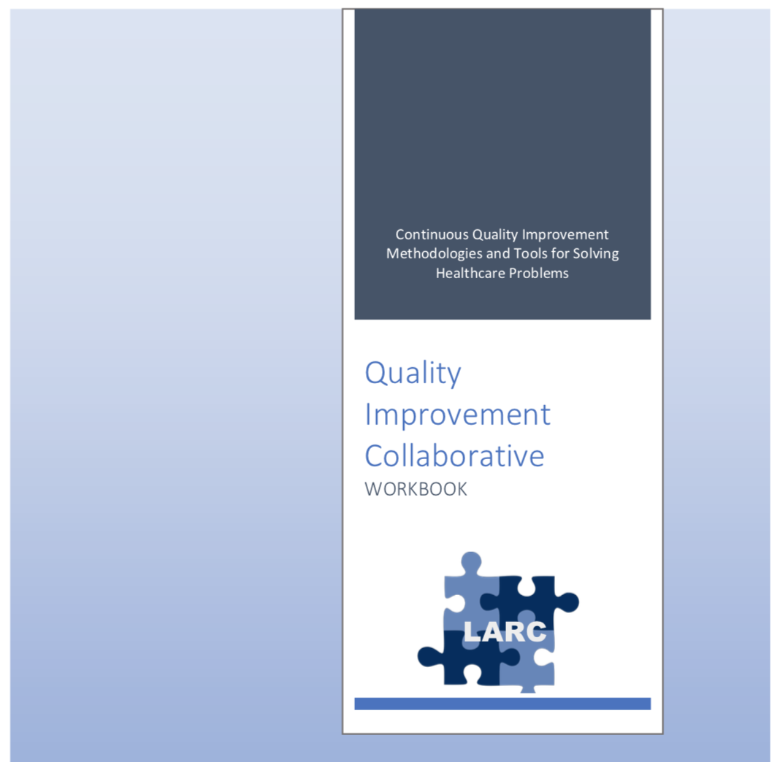
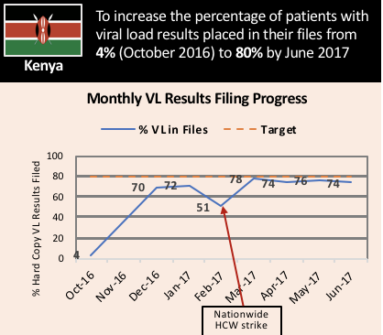
What is LARC? African Regional Improvement Collaborative focused on the Laboratory-Clinic Interface
LARC
Bringing together multidisciplinary clinical teams to improve any process or system
CURRICULUM: Quality Improvement (QI) Methodologies |  | DELIVERY MODEL: Learning Collaborative |  | OUTCOME
Focused on QI concepts, skills, tools & implementation 30+ QI Tools with Templates Coordinated step-by-step guidance through project Just-in-time training to produce QI project deliverables |  | Introductory Webinar 4 Learning Sessions – 1 On-Site Delivered over 6-9 months Action Periods Interspersed for Project Implementation Mentoring & Coaching Site Visits Learning shared among collaborative members |  | Improved Healthcare Delivery – Safer, higher-quality, client-centered Successfully Completed Project/s - Result-driven Embedded QI Concepts & Skills → Culture of Improvement

Slide 16
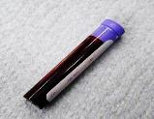
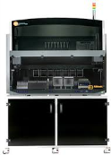
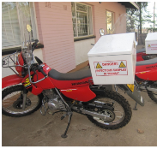
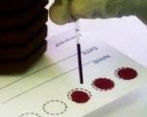
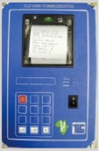
LARC = African Regional Improvement Collaborative
LARC
The Viral Load Cascade
Bringing together the laboratory and clinical cadres to implement and scale up HIV viral load testing
Demand Creation for Testing
Specimen Collection & Processing
Sample Transport
Laboratory Testing
Result Reporting & Interpretation by Clinician
Patient Management

Slide 17
STOP & SUMMARIZE
WHAT
WHY

Slide 18
Curriculum
Prerequisites
Deliverable-focused
CONTENT (PowerPoint)
WORKBOOK (Resource)
Notes:
The curriculum is the educational content of the program – the concepts, tools, skills, etc.
We will cover these 4 elements of the Curriculum next.

Slide 19
Prerequisites*
Assuring a standardized QI Knowledge
Prerequisites – Seven (7) Mandatory Courses
For Country Leads, Coaches & Team Members
Improvement Capability
QI 101: Introduction to Health Care Improvement (1hr:15 min) QI 102: How to Improve with the Model of Improvement (1hr:30 min) QI 103: Testing and Measuring Changes with PDSA Cycles (1hr:15 min) QI 104: Integrating data: Run Charts, Control Charts, and other Measurement Tools (1hr:30 min) QI 105: Leading Quality Improvement (1hr:15 min) QI 201: Planning for Spread, From Local Improvement to System-wide Change (1hr:15 min)
Leadership
L 101: Introduction to Health Care Leadership (1hr:15 min)
* From the Institute for Healthcare Improvement (IHI) Open School - http://www.ihi.org
Notes:
Important implications for in-country LARC leads, faculty, and site mentors

Slide 20
DELIVERABLE-FOCUSED
Project Deliverables
On-Site / Session 1
DEFINE / MEASURE / ANALYZE
Session 2
IMPROVE
Session 3
CONTROL
Identify Stakeholders
Team Formation
Map the Process (Current)
ID / Prioritize Opportunities
Project Outline
Baseline Metrics - Data Collection Tool/Plan
Action Plan
Elevator Speech
VOC Information
Root Cause Analysis
1 Rapid/Small Test of Change (PDSA)
Presentation
Update Project Outline, if necessary
1 5S Exercise
1 Visual Management Application
2 or more Tests of Change (PDSA)
Select and Implement Change
Modify Solution(s) where necessary by additional Test of Change (PDSA)
Create Future State Map
Standard Work
Presentation
Update Project Outline, if necessary
Validate Solution(s) / Interventions
Create Control Plan
Transfer to Operational Owner
Share/Spread Intervention, if applicable
Final Presentation
Project Champion
Notes:
Just in Time training to accomplish deliverables

Slide 21
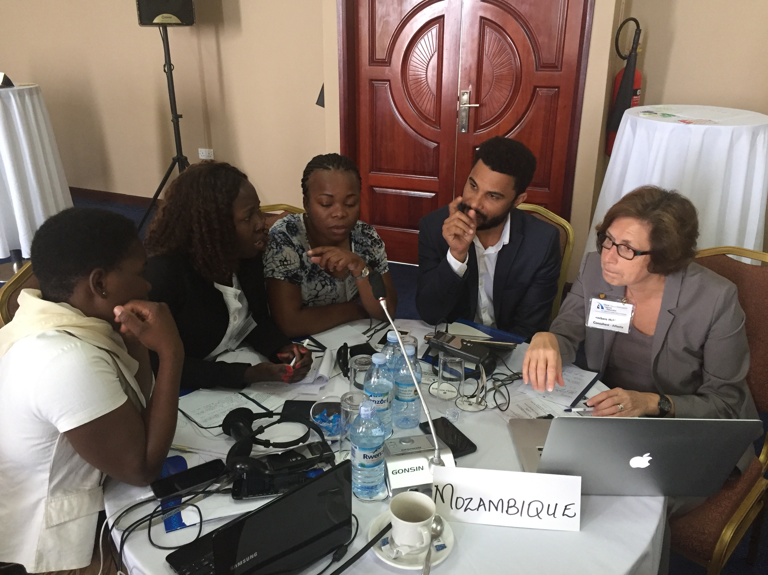
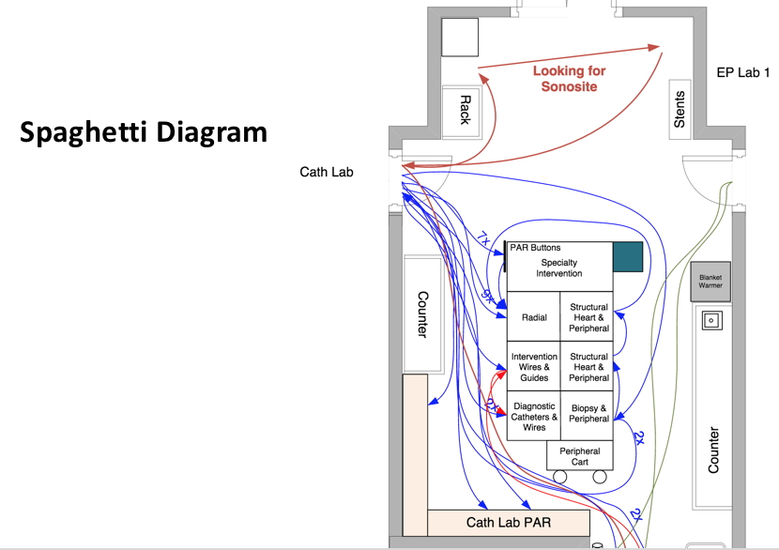
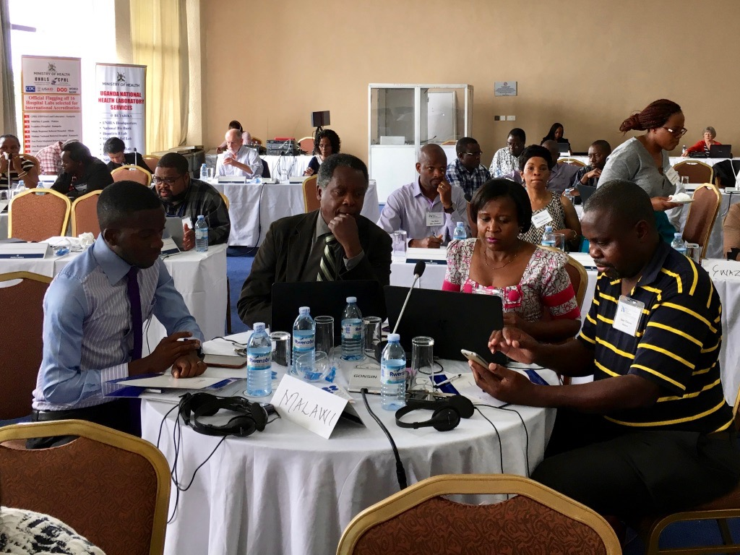
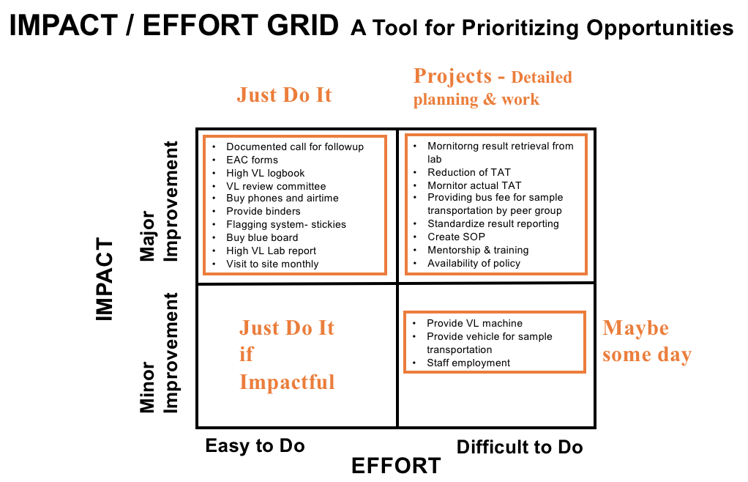
CONTENT: QI Concepts, Tools & Skills (PowerPoint) Presented in Learning Sessions
PowerPoint Presentations

Slide 22
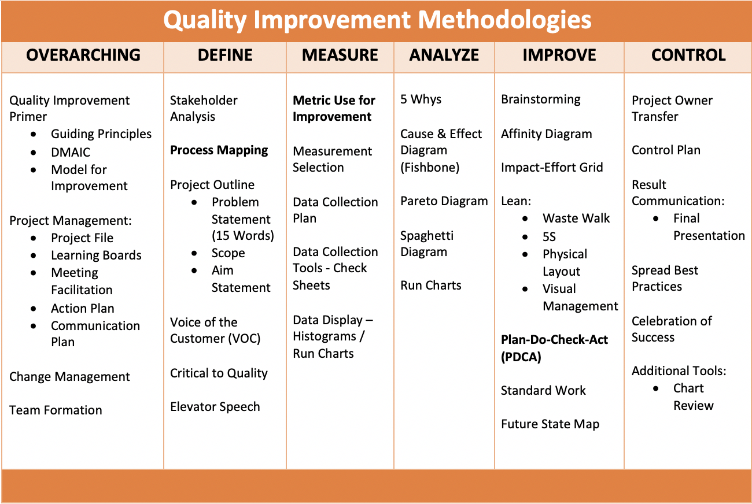
30+ Quality Improvement Tools
TOOL-BASED
WORKBOOK
Notes:
The curriculum is based on over 30 proven QI tools (Details not important – just to see the number of tools)
LARC 2.0 - New Tools Added – Change Management, Voice of the Customer, Etc.
Enhanced practical training on the use of each tool

Slide 23
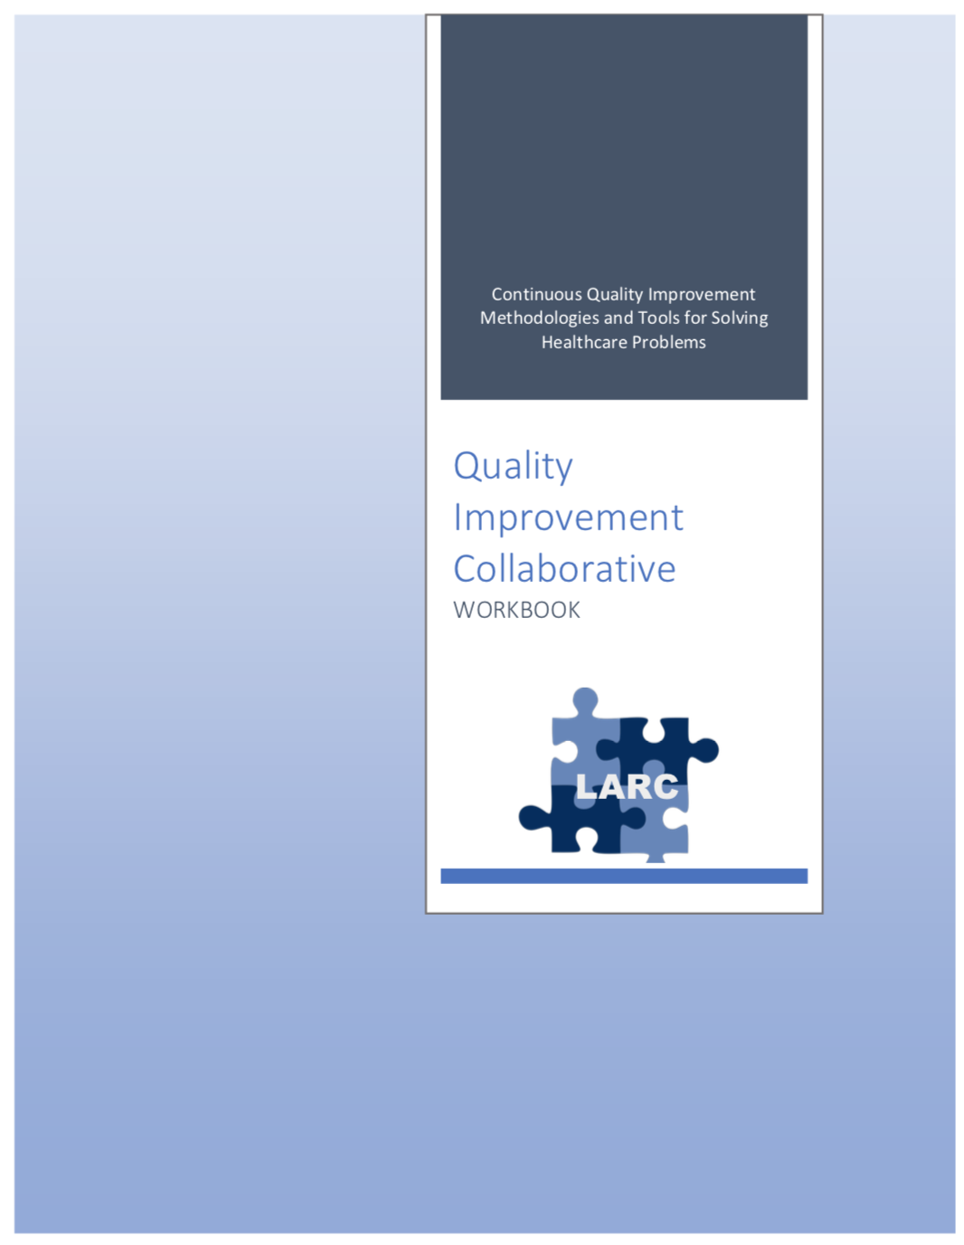
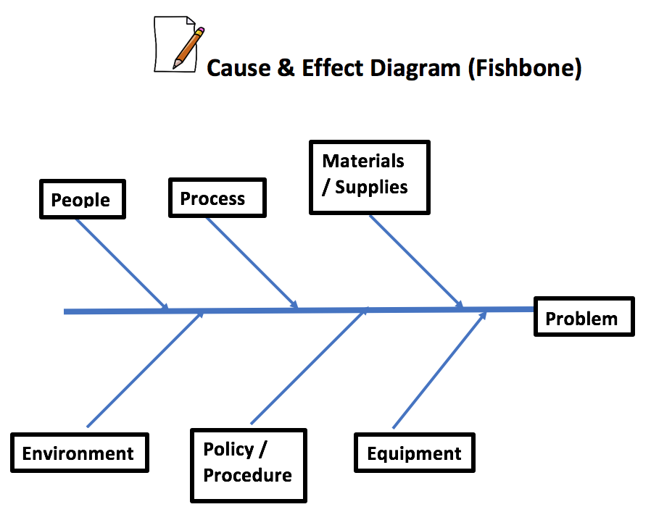
WORKBOOK
QI TOOL RESOURCE
30+ Tools in 80+ pages
Notes:
Leave behind resource with all the tools & templates

Slide 24
Delivery Model
Timeframe
Pre-training Preparation – Intorductory Webinar
On-Site Smart Start Session
Accountability/Follow-Up
Notes:
Let’s look at the following 4 aspects of the way that the LARC curriculum will be delivered

Slide 25
Planning & Preparation for LARC Sessions: Checklist
Planning Checklist
Step-by-Step Planning for Sessions
Notes:
Focus on planning & preparation before the first in-country session – a key to the success of the project; Implications significant for in-country leadership

Slide 26
Quality Improvement Collaborative Overview: Program Delivery
Introduction: Webinar
Session I: Define Measure Analyze
Session II: Simulation Improve
Smart Start: On-Site Session
Session III: Control Share/Report
Final Report
Total
= 6-9
Months
2 Months
1 Week
2-3 months
2-3 months
1 Month
Preparation
Project Outline
Action Period
Action Period
Report Completion

Slide 27
Quality Improvement Collaborative Overview: Program Delivery
Introduction Webinar
Launch
Session I
Session II
Session III
Final Report
Smart Start
(on site)
Total Implementation Period = 6 Months
2 Months
2 months
2 months
1 Month
Project Outline
Action Period
Action Period
Action Period
Report
Completion
Preparation
Notes:
Still the collaborative model – learning sessions and action periods, but Shortened

Slide 28
Introductory Webinar
Conducted 2 months prior to the first Smart Start Session to:
Sensitize & engage stakeholders
Orient teams
Complete planning and preparation to ensure readiness before launch and/or Smart Start
Target Audience:
In country leadership
Faculty/coaches
Facility teams
Notes:
2 New sessions:
The introductory webinar is for the in-country leadership, faculty, site mentors, coaches & team leaders.
Key purposes:
Sensitization
Identifying & engaging stakeholders
Selecting & engaging team
Assuring planning & preparation complete prior to the first Smart Start Session – Essential to the success of this new model

Slide 29
Quality Improvement Collaborative Overview: Program Delivery
Introduction Webinar
Launch
Session I
Session II
Session III
Final Report
Smart Start
(on site)
Total Implementation Period = 6 Months
2 Months
2 months
2 months
1 Month
Project Outline
Action Period
Action Period
Action Period
Report
Completion
Preparation
Notes:
Still the collaborative model – learning sessions and action periods, but Shortened

Slide 30
Smart Start: 2-Day On-Site Session
Expected Outcomes:
Understanding of the current state via process mapping
Opportunities for Improvement (OFI) identified
Select project / Write problem statement
Project Outline:
Aim statement
Measures and data collection plan/tools
Intervention (the change to be implemented)
Action and communication plans
Purpose:
To set the site up for successful project implementation
To standardize mentorship practice by different coaches across all project sites
Notes:
The Smart Start Session – NEW Session
Purpose:
To clearly understand the problem through process mapping
To provide direction to start the improvement work – quicker, faster, smarter
A critical new session to get the project off to a productive start – On-site coaching of the team in process mapping and project implementation

Slide 31
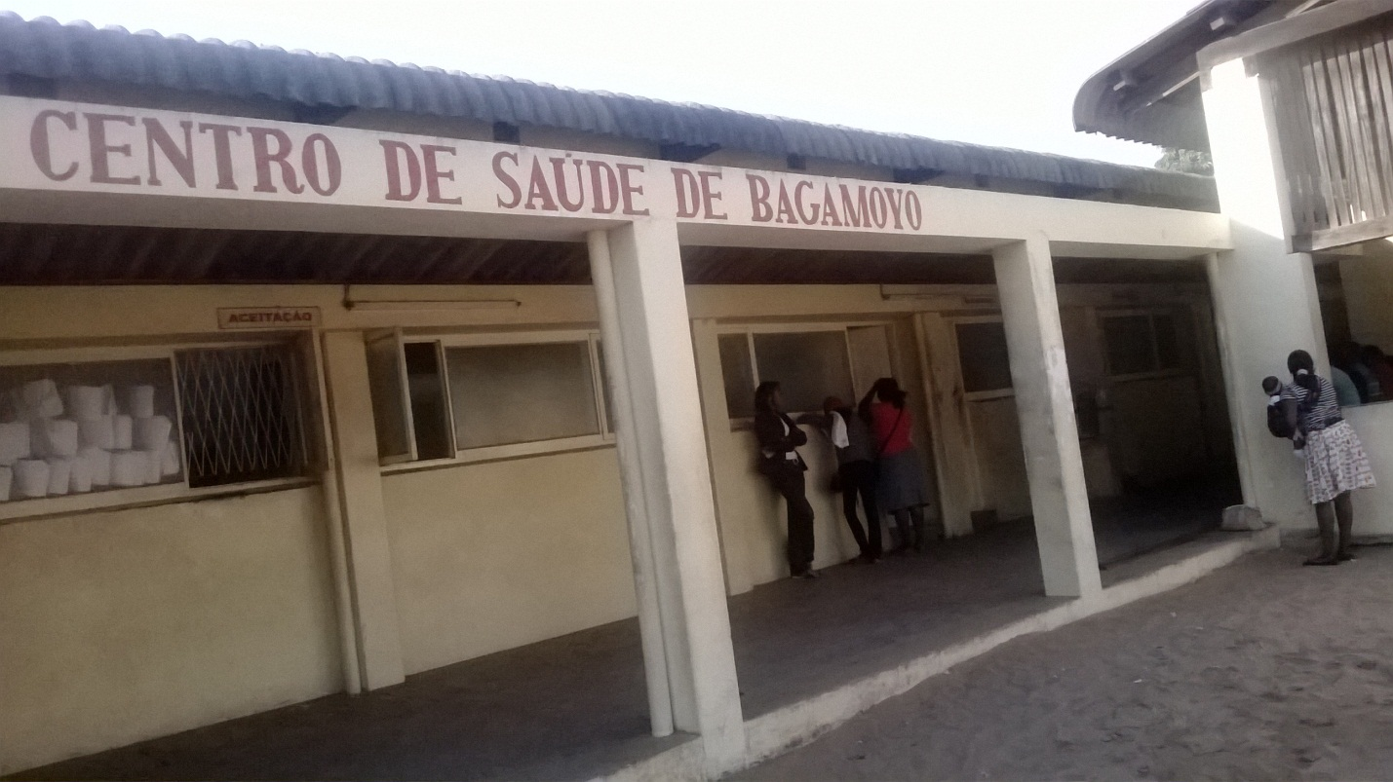
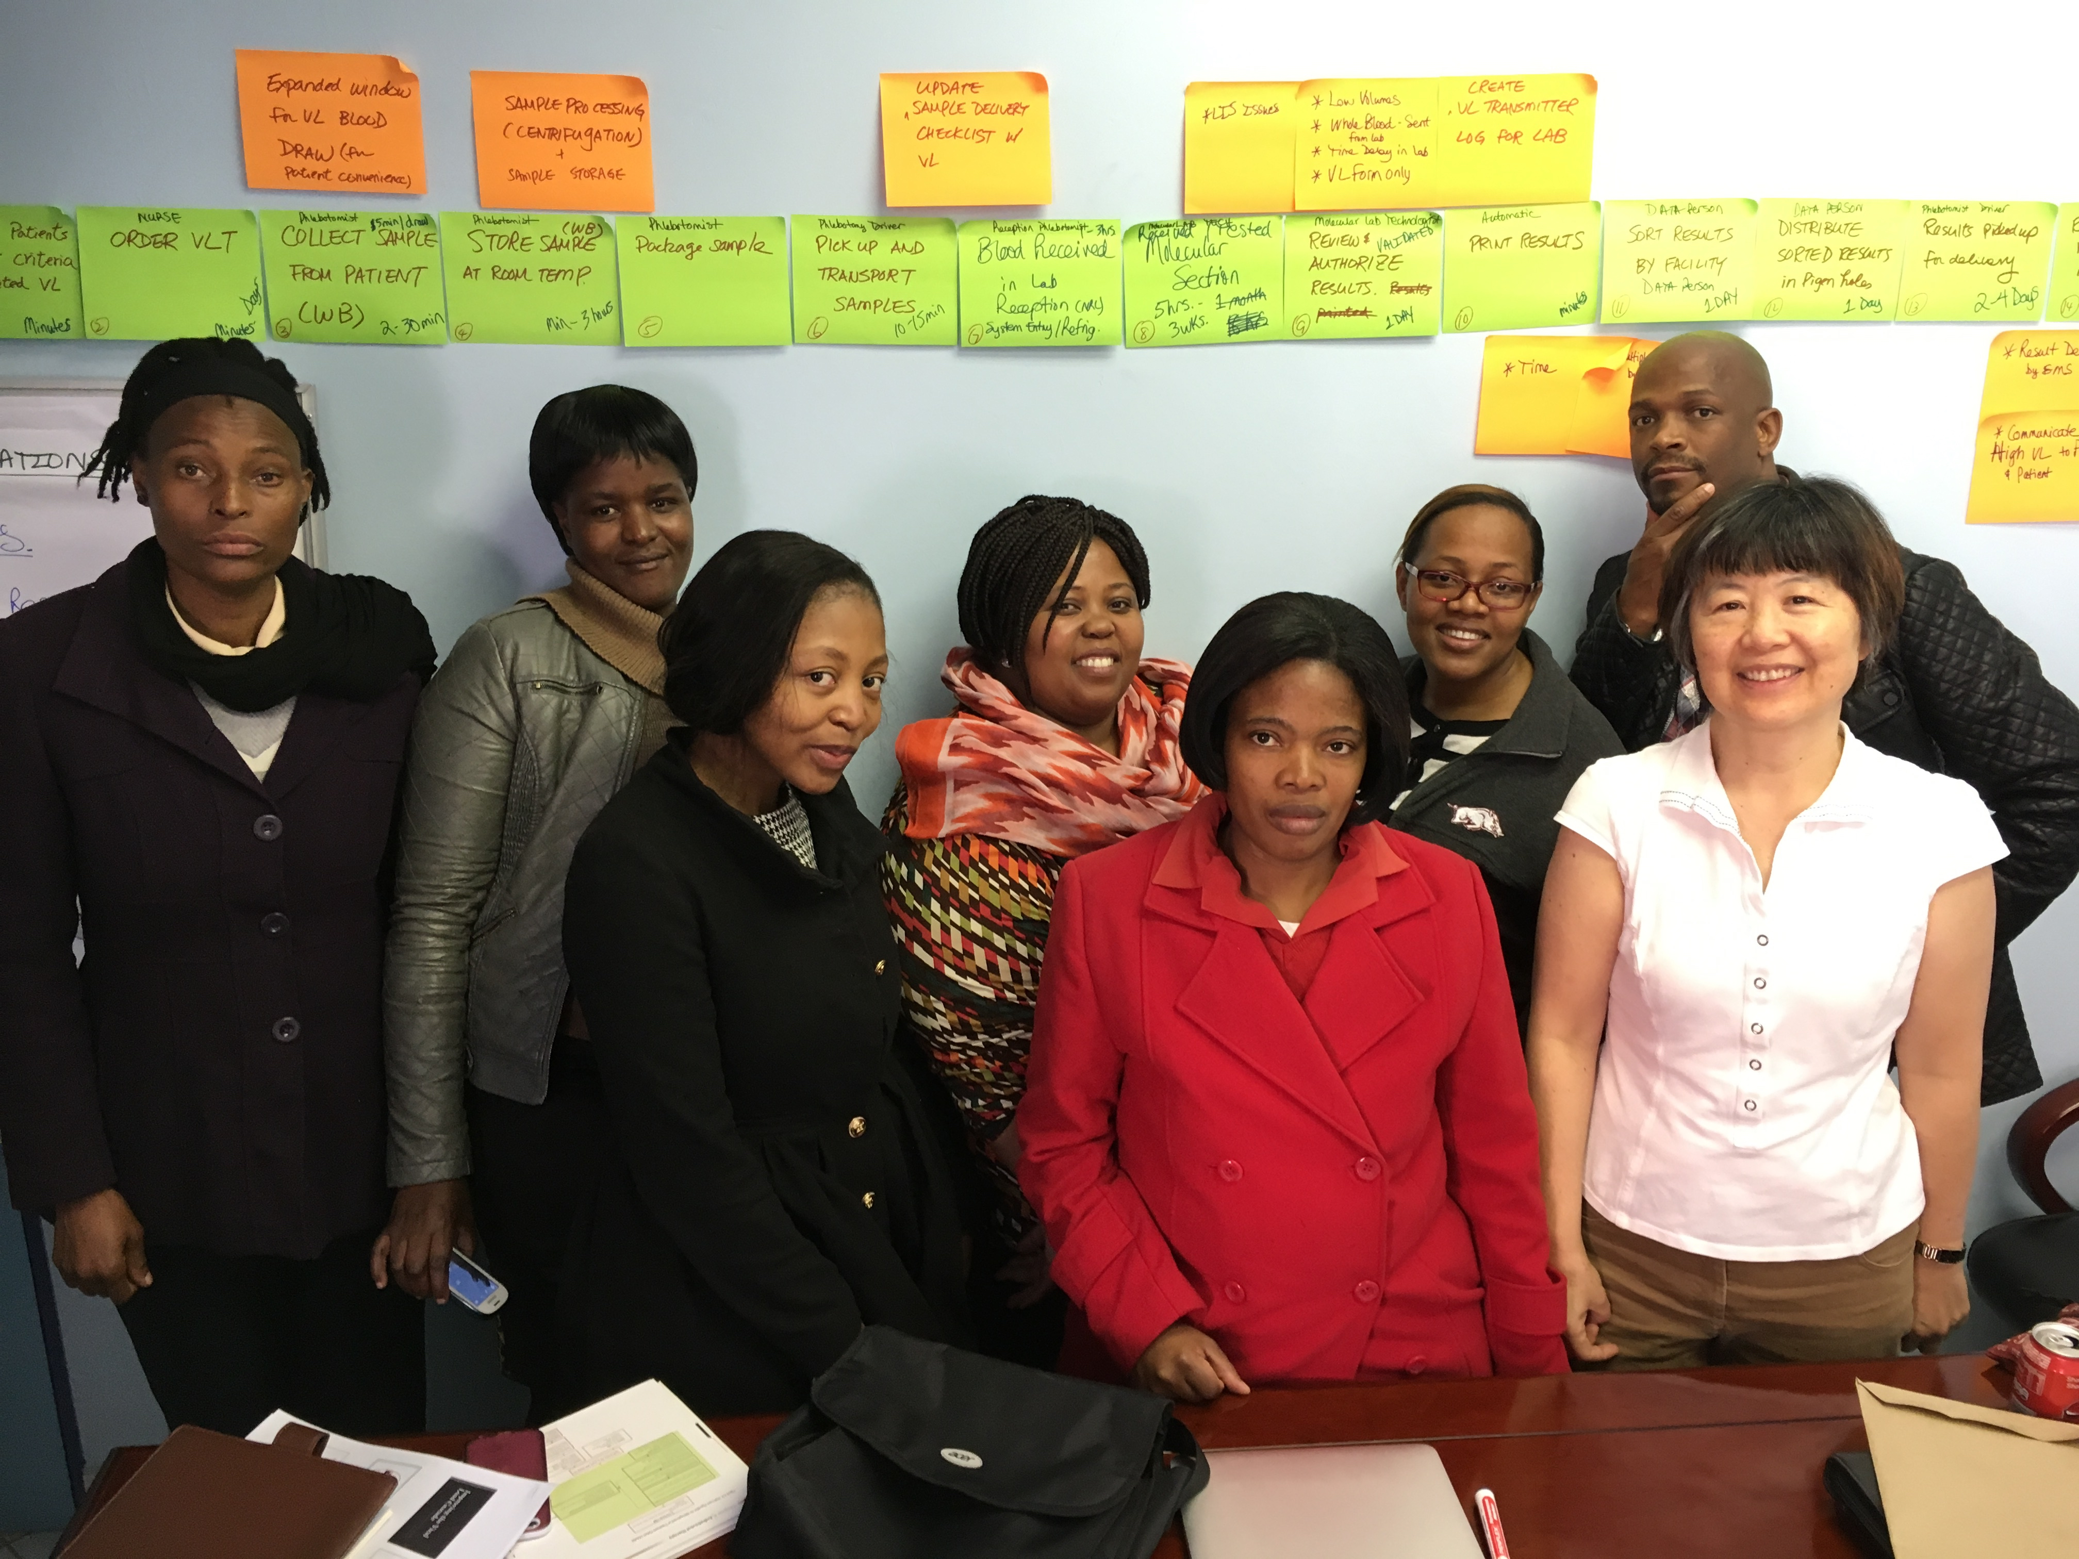
Smart Start
Day #1 | Day #2
Orientation Process Mapping Current State (Conference Room) | Identify / Prioritize Opportunities For Improvement (OFI) Problem Statement
Process Mapping @ Site - Go and See | Project Implementation – Outline & Action Plan Project Communication
Notes:
Conducted in several of the countries for LARC 1.0

Slide 32
SESSION | Introductory Webinar | Smart Start: 2-Day On-Site | Learning Session #1 | Learning Session #2 | Learning Session #3
CONTENT | Quality Improvement Primer - Guiding Principles DMAIC Model for Improvement Data/ Measurement Overview Stakeholder Analysis Team Formation Planning for Smart Start / Process Mapping | DEFINE / MEASURE Process Mapping Brainstorming / Affinity Diagram Prioritize Opportunities for Improvement (OFIs) Impact/Effort Grid Project Outline Problem Statement Scope Aim Statement / Metric Elevator Speech Action Plan Communication Plan | Quality Improvement Review Smart Start Outputs PDCA Overview Project Mgmt. Change Mgmt. Voice of Customer Critical to Quality Data/Measurement ANALYZE 5 Whys, Cause & Effect Diagram, Pareto Diagram, Spaghetti Diagram, Run Charts/Control Charts | IMPROVE Simulation Before/After PDCA / Small Test of Change Lean 5S Visual Management Physical Layout Standardized Work Future State Process Map Data Display | CONTROL Process Owner Transfer Control Plan Result Communication Final Report Storyboard Presentation Spread Best Practices Celebrate Success Additional Tools Chart Review Avoiding Pitfalls

Slide 33
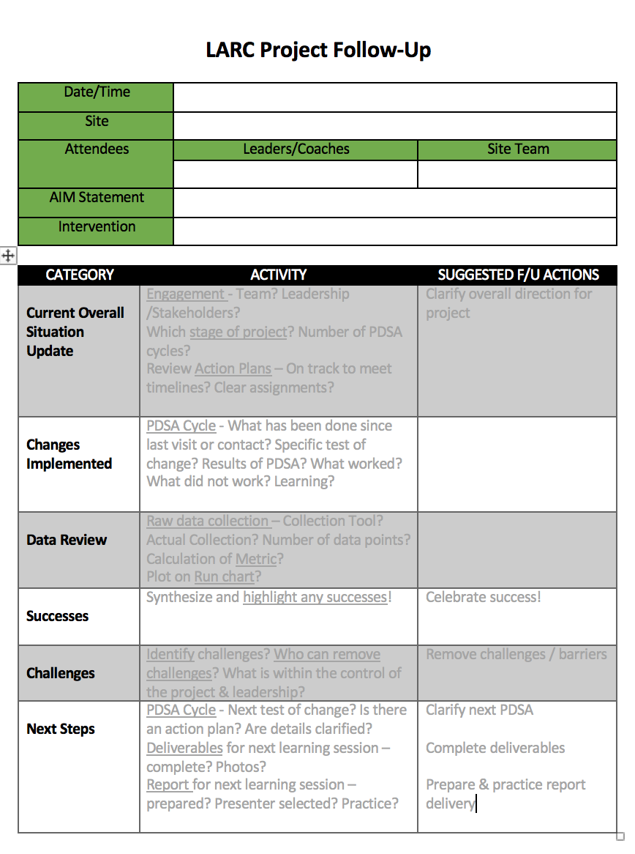
After each training session: Accountability and Follow-Up
Focus on Project Follow-up
Site Visits
Phone Calls
Mentoring
Coaching
Notes:
Assuring that there is ACTION in the Action Periods

Slide 34
Plan for Spread from the Very Beginning
IHI Open School Course
Learn the Improvement Methodologies
Start Small – Small tests of change
Select changes that result in improvement
Implement changes that result in improvement
Plan for Implementation at Scale
Notes:
Just a reminder for the countries – start small and plan for spread from the beginning
Encourage the country LARC leaders to take the IHI course early – while ”piloting” LARC 2.0 so they will be ready for spread when the “pilot” is complete

Slide 35
STOP & SUMMARIZE

Slide 36
Quality Improvement
Change/Model for Improvement
DMAIC
Guiding Principles

Slide 37
Quality Improvement is all about CHANGE!
Old Process
Tests of CHANGE
Sustain the New CHANGE
Implement the New CHANGE
Notes:
The skeleton of the Quality Improvement process…

Slide 38
How do we create change?
3 Questions + PDCA = The Model for Improvement

Slide 39
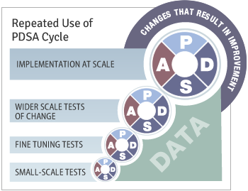
Quality Improvement Overview
Old Process
Tests of CHANGE
Implement the New CHANGE
Sustain the New CHANGE
Define
Measure
Analyze
Improve
Control

Slide 40
Guiding Principles for Quality Improvement
Focus on the needs of the USERS
Focus on PROCESSES to increase the productivity of work
Use DATA to improve services
Use TEAMS to improve quality
Improve COMMUNICATION

Slide 41
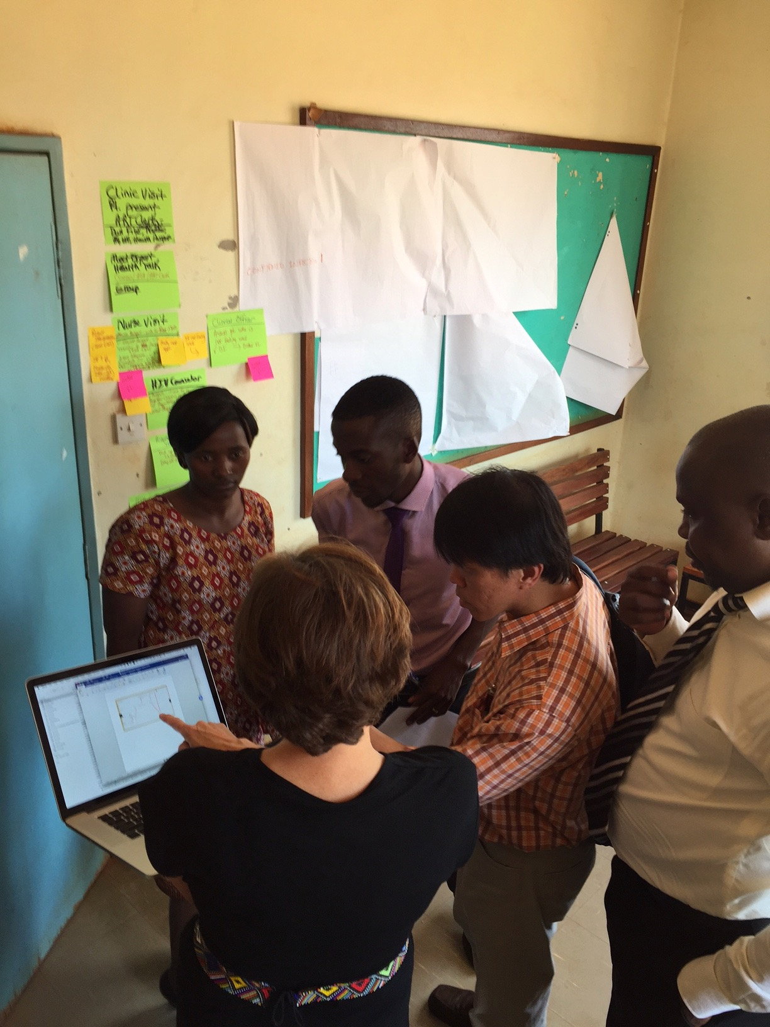
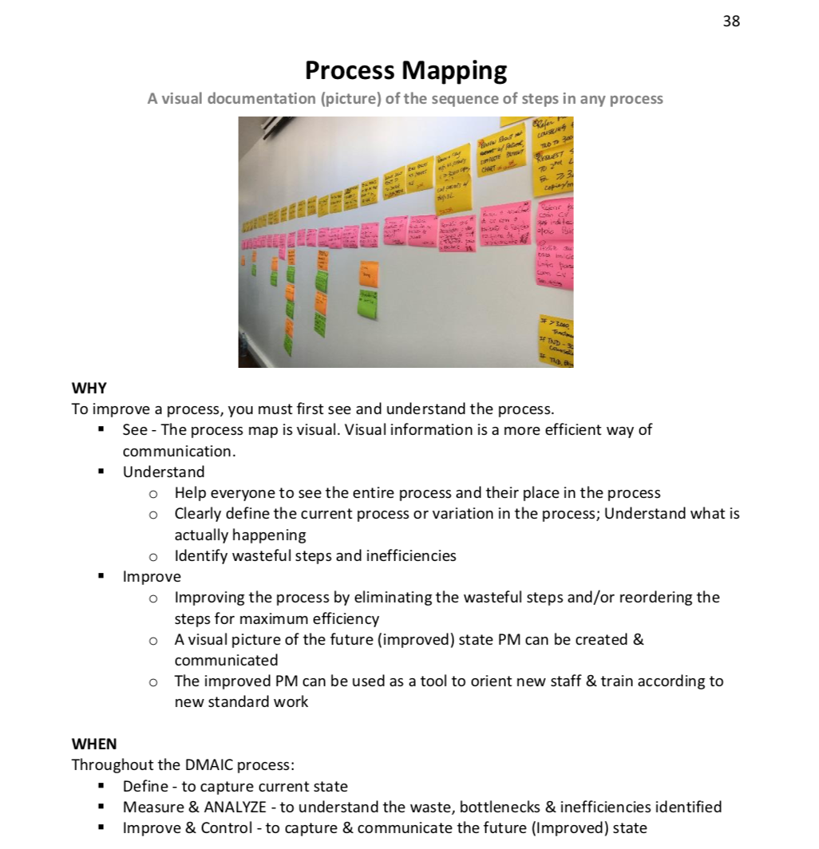
Process Mapping
RESOURCE: WORKBOOK

Slide 42
“What gets measured, gets fixed.”
DATA

Slide 43
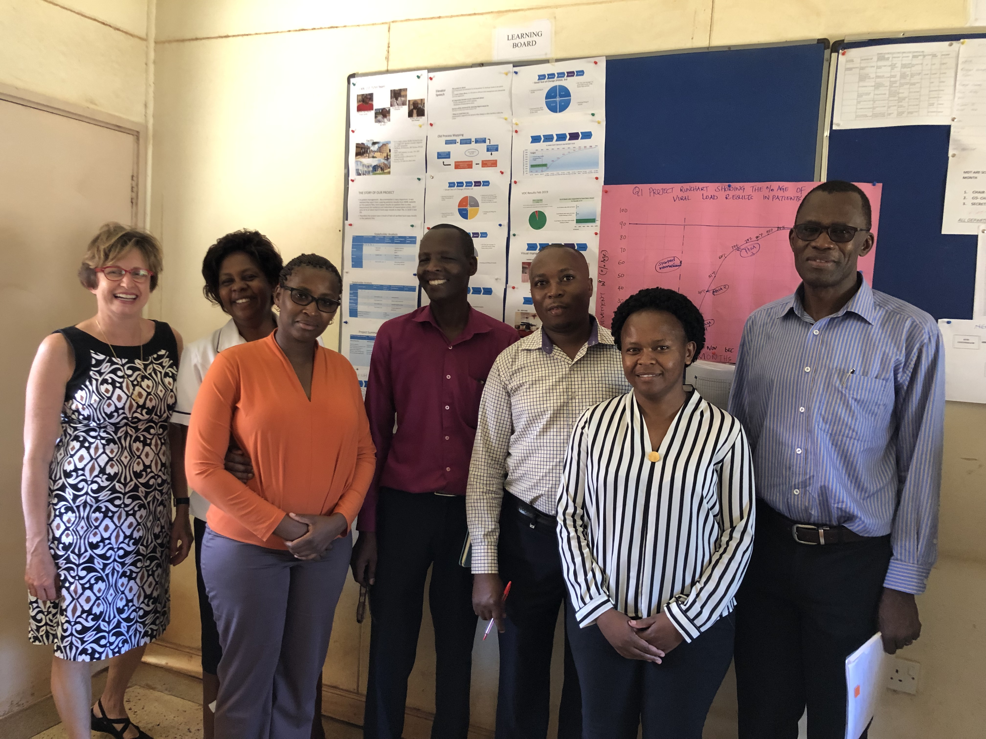
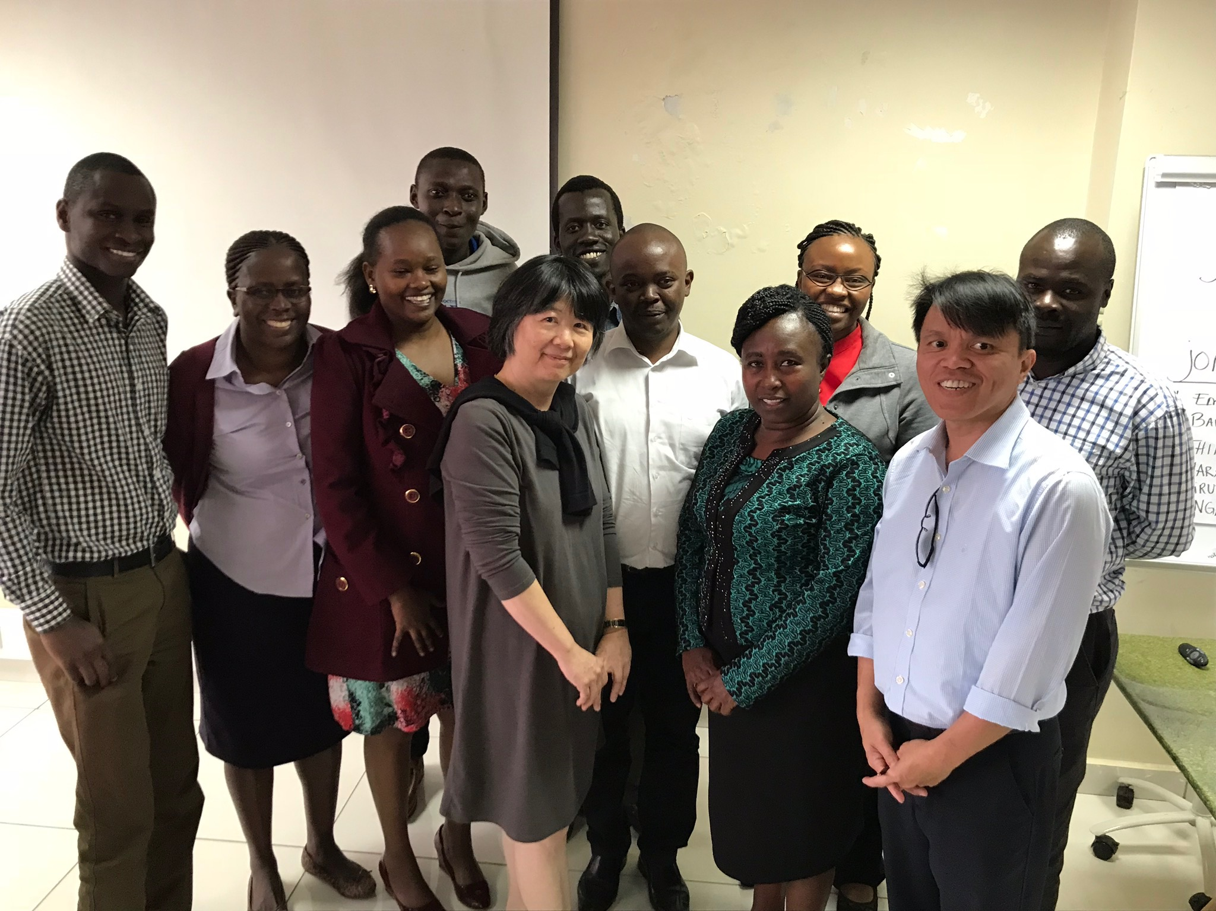
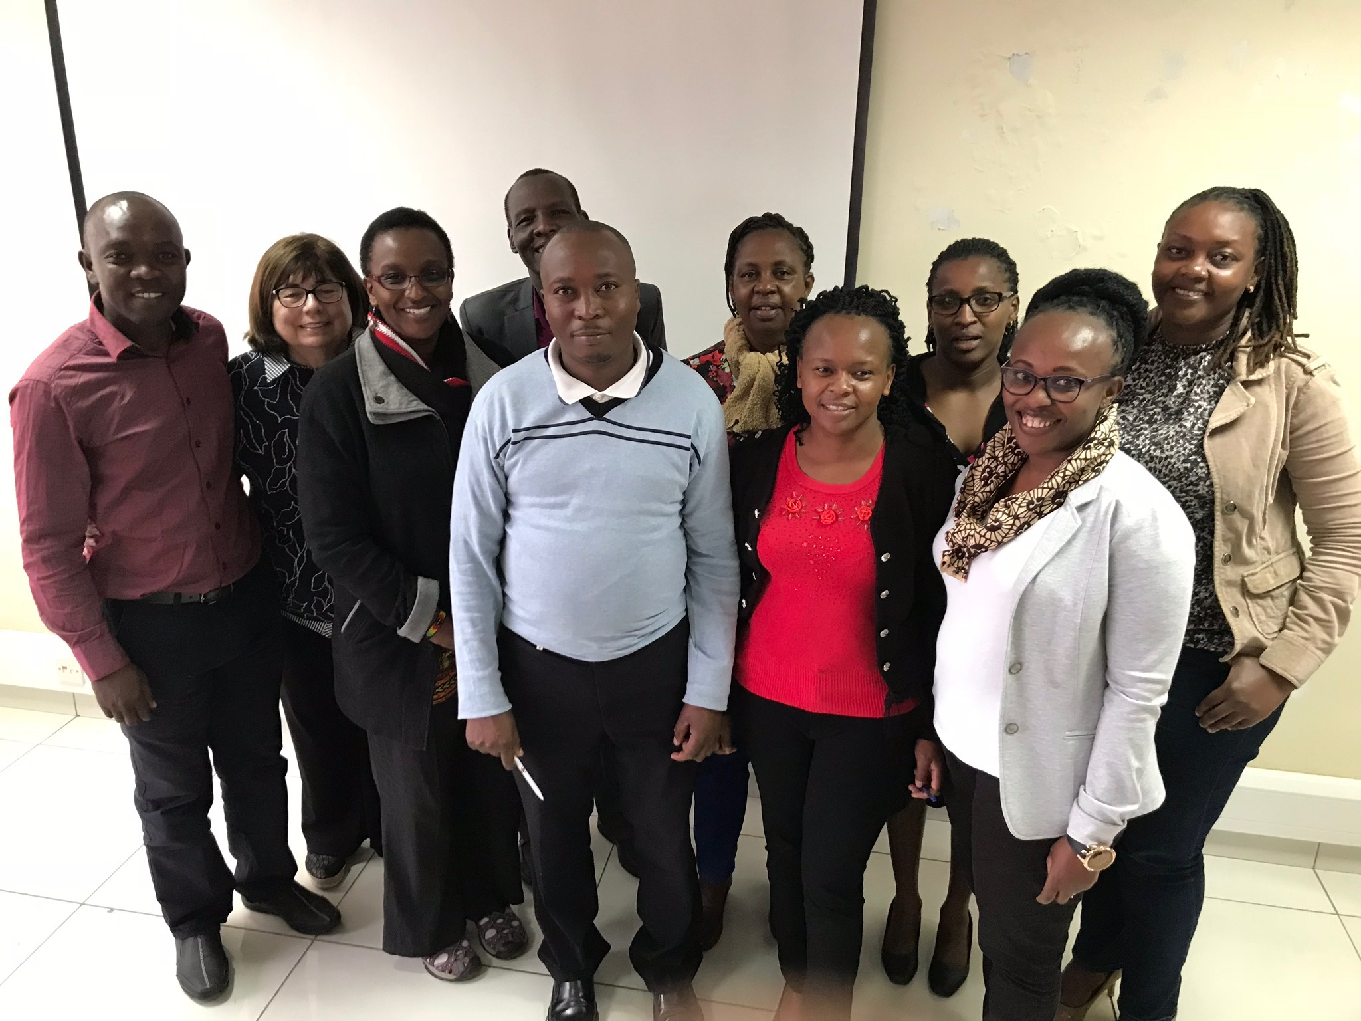
TEAMS: Multidisciplinary

Slide 44
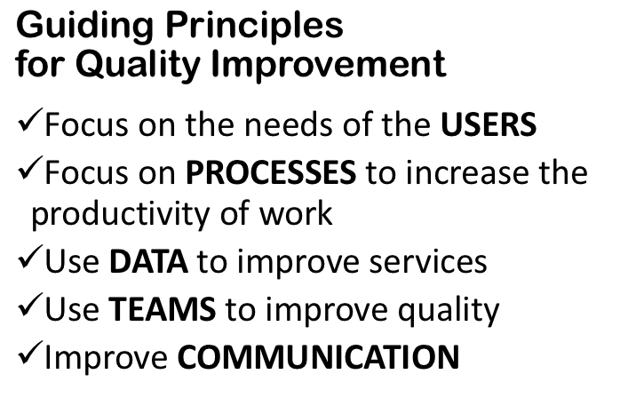
STOP & SUMMARIZE
CHANGE
LEARNING

Slide 45
larccqi.org

Slide 46
larccqi.org

Slide 48
Preparation for the LARC Initiative
Coaches / Mentors
Stakeholder Analysis
Team Formation
Timeline / Checklist

Slide 49
Coaches / Mentors: Roles & Responsibilities
Learning Sessions
Site Visits
Assist facility teams to:
Learn & utilize CQI tools
Complete project successfully
IHI Open School
7 Courses

Slide 50
Coaching Network = Learning Network
LARC FACULTY
COACH D
COACH C
COACH B
COACH A
Monthly Calls
Project Updates
Successes
Challenges

Slide 51
Stakeholder Analysis

Slide 52
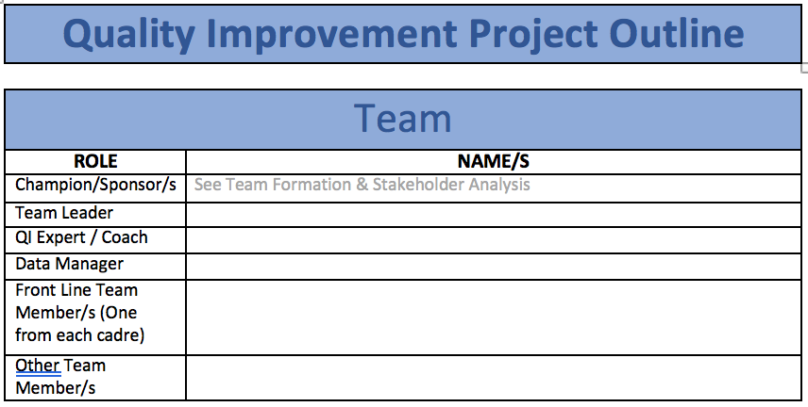
Team Formation

Slide 53
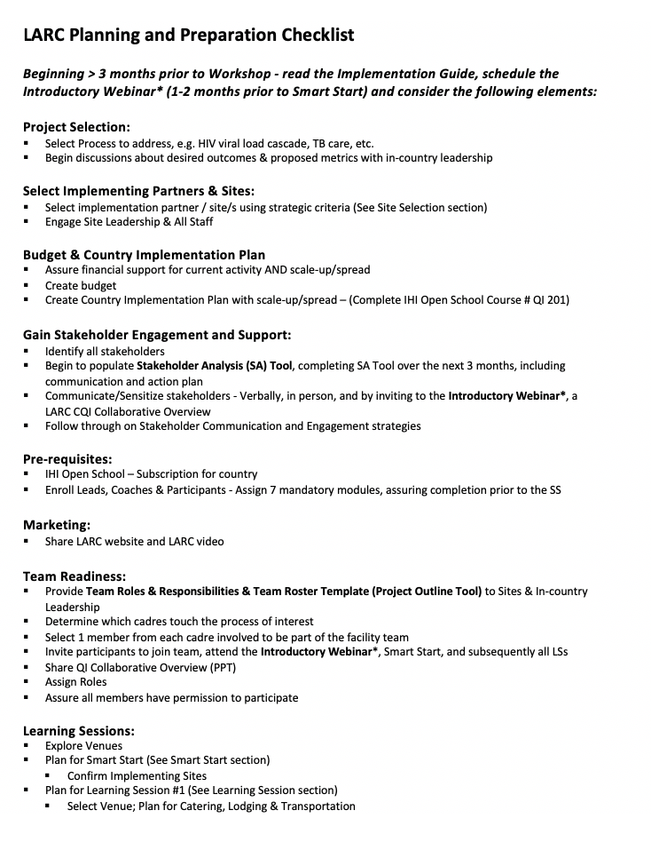
LARC Planning & Preparation Checklist
Planning Checklist
Step-by-Step Planning
Notes:
The planning & preparation are essential to a successful LARC implementation. This is new to LARC 2.0 and will require a significant amount of focus, commitment, time and resources – not to be taken lightly!

Slide 54
STOP & SUMMARIZE
STAKEHOLDER ANALYSIS
CHECKLIST
TEAM FORMATION

Slide 55
Preparation for Smart Start: The 2-Day On-Site Session

Slide 56
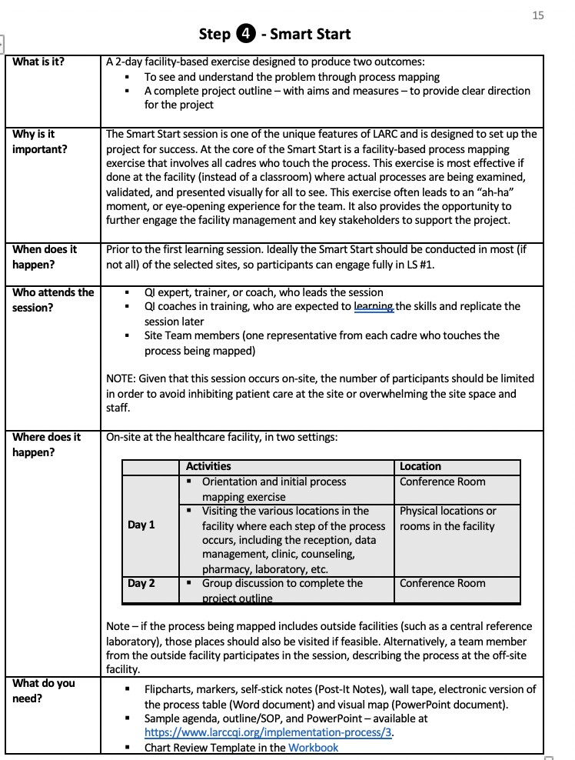
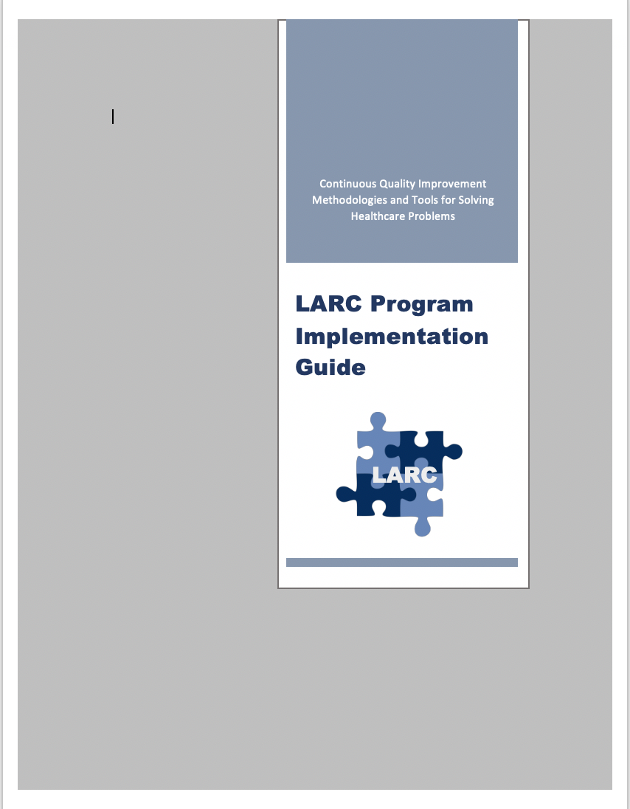
Implementation Guide
larccqi.org

Slide 57
Quality Improvement Collaborative
Thank You
LARC
LARC

Slide 58
Questions
Thank You
??????????????????

